Slide 1
Object Oriented Programming
Object-Oriented Programming
Object-Oriented Programming (01CT0105)
Dr. Chirag Joshi
Department of ICT Marwadi University
chirag.joshi@marwadieducation.edu.in

Slide 2

Introduction to

Slide 3
JAVA
Java is a general-purpose computer-programming language that is open source, platform independent, object-oriented and specifically designed to have as few implementation dependencies as possible.
Java was originally developed by James Gosling at Sun Microsystems and released in 1995.
Java was initially named as Oak language and renamed to JAVA in 1995.
Current Version | Java SE 19.0. 2 (as of Feb, 10th 2023)
Version we will use | Java SE 17.0.6 (LTS)
Setup size | 149 MB (Linux), 153 MB (Windows x64)
Download Link | https://www.oracle.com/in/java/technologies/downloads/
Official Website | https://java.com
Integrated Development Environment (IDE) | Eclipse NetBeans IntelliJ IDEA Community Edition BlueJ

Slide 4
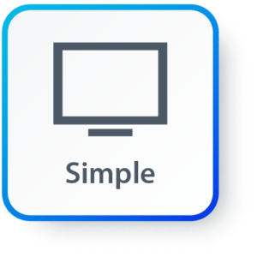
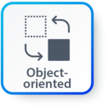


Features of JAVA
Simple: Java inherits C/C++ syntax and many object-oriented features of C++.
Object Oriented: “Everything is an object” paradigm, which possess some state, behavior and all the operations are performed using these objects.
Robust: Java has a strong memory management system. It helps in eliminating error as it checks the code during compile and runtime.
Multithreaded: Java supports multiple threads of execution, including a set of synchronization primitives. This makes programming with threads much easier.

Slide 5



Features of JAVA (Cont.)
Architectural Neutral: Java is platform independent which means that any application written on one platform can be easily ported to another platform.
Interpreted: Java is compiled to bytecodes, which are interpreted by a Java run-time environment.
High Performance: Java achieves high performance through the use of bytecode which can be easily translated into native machine code. With the use of JIT (Just-In-Time) compilers, Java enables high performance.

Slide 6

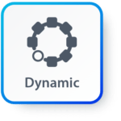
Features of JAVA (Cont.)
Distributed: Java provides a feature which helps to create distributed applications. Using Remote Method Invocation (RMI), a program can invoke a method of another program across a network and get the output. You can access files by calling the methods from any machine on the internet.
Dynamic: Java has ability to adapt to an evolving environment which supports dynamic memory allocation due to which memory wastage is reduced and performance of the application is increased.

Slide 7
Components of Java
Java Virtual Machine (JVM)
Java Runtime Environment (JRE)
Java Development Kit (JDK)
JDK
Compiler (javac.exe)
Java Application
Launcher (java.exe), AppletViewer, etc..)
Java Packages
(math, util, awt etc…)
JVM
Runtime Libraries
Development tools
JRE

Slide 8
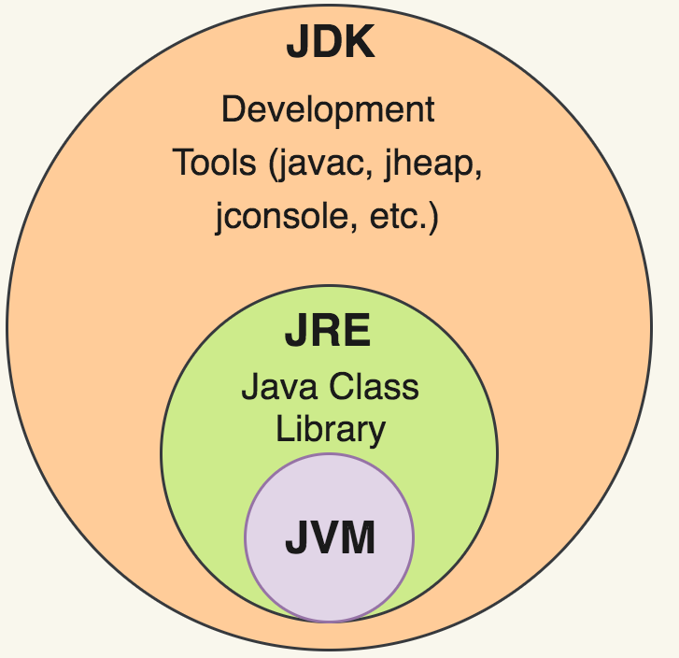
Java Development Kit (JDK)
JDK contains tools needed ,
To develop the Java programs and
JRE to run the programs.
The tools include
compiler (javac.exe),
Java application launcher (java.exe),
Appletviewer, etc…
Java application launcher (java.exe) opens a JRE, loads the class, and invokes its main method.

Slide 9
Java Runtime Environment (JRE)
The JRE is required to run java applications.
It combines the Java Virtual Machine (JVM), platform core classes and supporting libraries.
JRE is part of the Java Development Kit (JDK), but can be downloaded separately.
It does not contain any development tools such as compiler, debugger, etc.

Slide 10
Java Virtual Machine (JVM)
JVM is a virtual machine that enables a computer to run Java programs as well as programs written in other languages and compiled to Java Bytecode.
Bytecode is a highly optimized set of instructions designed to be executed by the Java Virtual Machine(JVM).
Byte code is intermediate representation of java source code.
Java compiler provides byte code by compiling Java Source Code.
Extension for java class file or byte code is ‘.class’, which is platform independent.
JVM is virtual because , It provides a machine interface that does not depend on the operating system and machine hardware architecture.
JVM interprets the byte code into the machine code.
JVM itself is platform dependent, but Java is Not.

Slide 11
How Java become Platform Independent?
Source code (Program)
.java file
Compiler
Bytecode
.class file
JVM
(Windows)
JVM
(Linux)
JVM
(Mac)
Machine Code
Machine Code
Machine Code

Slide 12
Java Interview Question
Difference between JRE and JVM?
Difference between interpreter and JIT compiler?
Why Java is platform independent?
What are Java bytecodes?
JVM vs. JRE vs. JDK

Slide 13
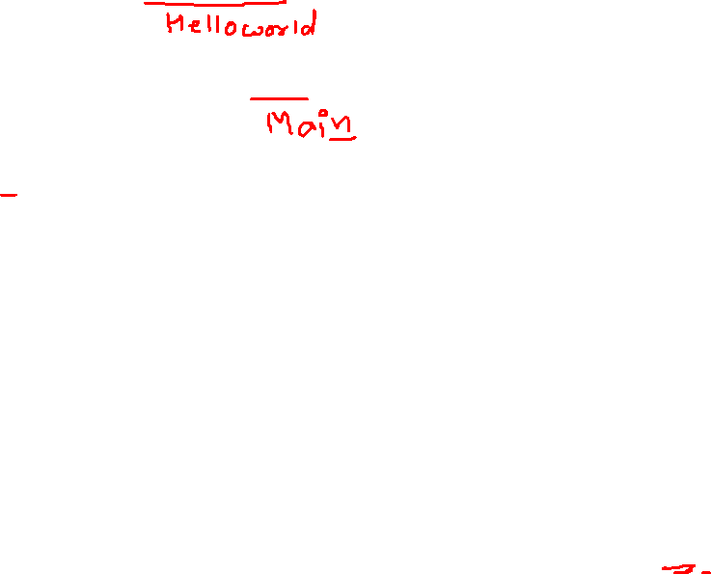
Hello World Java Program
File must be saved as HelloWorld.java
public class HelloWorld
{
public static void main(String[] args)
{
System.out.println("Hello World");
}
}
We have to save this in HelloWorld.java file as it has public class named HelloWorld.
String and System are inbuilt Java Classes.
Classes in java are always written in Camel case.
Main method from where execution will start
String must start with capital letter
System must start with capital letter

Slide 14
How to execute Java Program?
Save the program with the same name as the public class with .java extension.
Open command prompt (cmd) / terminal & navigate to desired directory / folder.
Compile the “.java” file with javac command.
Execute the “.class” file with java command without extension.

Slide 15
Tokens

Slide 16
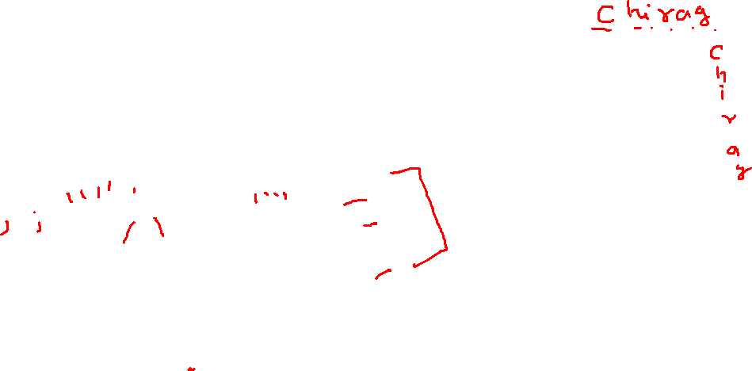
Tokens
The smallest individual unit of a language / program is known as a token.
Tokens are basic building blocks of any language.
“Jane bakes tasty cookies.”
Jane is noun
bakes is verb
tasty is adjective
cookies is noun
‘.’ is special character to end the sentence.
Each and every word and punctuation is a token.
We divide sentence into tokens to understand the meaning of a sentence.
Similarly, the compilers of programming language breaks a program into the tokens and proceeds to the various stages of the compilation.
However, collection of tokens in appropriate sequence makes a meaningful sentence.

Slide 17
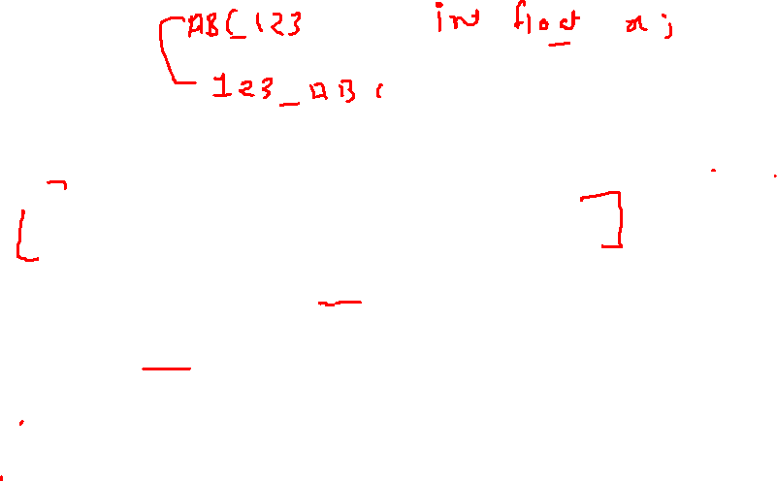
Classification of Tokens
Sr. | Token | Description | Examples
1 | Keywords | Predefined reserved words | void, int, float, for, if
2 | Identifiers | User-defined combination of alphanumeric characters. Name of a variable, function, class, etc. | a, i, sum, number, pi
3 | Constants | Fixed values that do not change | 17, -25.50, 82, 0
4 | Strings | A sequence of characters | “Darshan”, “Hi!”
5 | Special Symbols | Symbols that have special meaning | #, $, @, %, =, :, ;
6 | Operators | A symbol that performs operation on a value or a variable | +, -, *, /

Slide 18
Identifiers

Slide 19

Identifiers
They are used for class names, method names and variable names.
An identifier may be any descriptive sequence of
uppercase(A…Z) and lowercase(a..z) letters
Numbers(0..9)
Underscore(_) and dollar-sign($) characters
Examples for valid Identifiers,
AvgTemp
count
a4
$test
this_is_ok
Examples for invalid Identifiers,
2count
High-temp
Ok/NotOK
(Identifiers can not start with digit)
(Identifiers can not contain dash)
(Identifiers can not contains slash)

Slide 20
Identifier Name Valid or Invalid?
for | Rajkot | _Name | If | Roll Number | Rs.
_________a | int | student | _7 | Identifier | Valid
C | C++ | Java | C# | Compiler | ___8__a__8
7Student | Who? | v.a.l.u. | A_B_C_D_E | i | if
Int | A2020 | 2021 | sum | a,b,c | i;

Slide 21
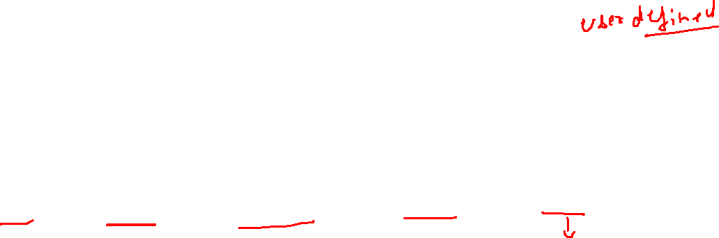
Data Types
Java Datatypes
Primitive
Non-primitive
Integers
Floating-point numbers
Characters
Boolean
Class

Slide 22
Primitive Data Types
Data Type | Size | Range | Example
byte | 1 Byte | -128 to 127 | byte a = 10;
short | 2 Bytes | -32,768 to 32,767 | short a = 200;
int | 4 Bytes | -2,147,483,648 to 2,147,483,647 | int a = 50000;
long | 8 Bytes | -9,223,372,036,854,775,808 to 9,223,372,036,854,775,807 | long a = 20;
float | 4 Bytes | 1.4e-045 to 3.4e+038 | float a = 10.2f;
double | 8 Bytes | 4.9e-324 to 1.8e+308 | double a = 10.2;
char | 2 Bytes | 0 to 65536 (Stores ASCII of character) | char a = ‘a’;
boolean | Not defined | true or false | boolean a = true;

Slide 23
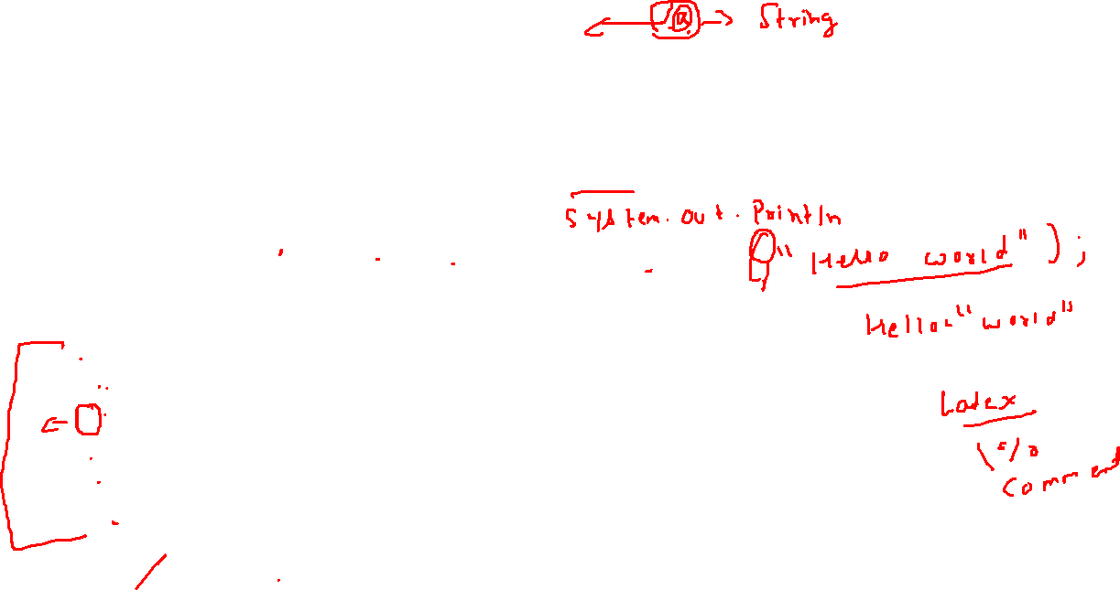
Escape Sequences
Escape sequences in general are used to signal an alternative interpretation of a series of characters.
For example, if you want to put quotes within quotes you must use the escape sequence, \", on the interior quotes.
System.out.println("Good Morning \"World\"");
Escape Sequence | Description
\’ | Single quote
\” | Double quote
\\ | Backslash
\r | Carriage return
\n | New Line
\t | Tab

Slide 24
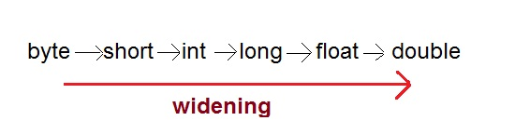
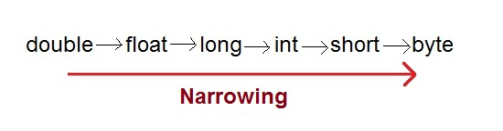
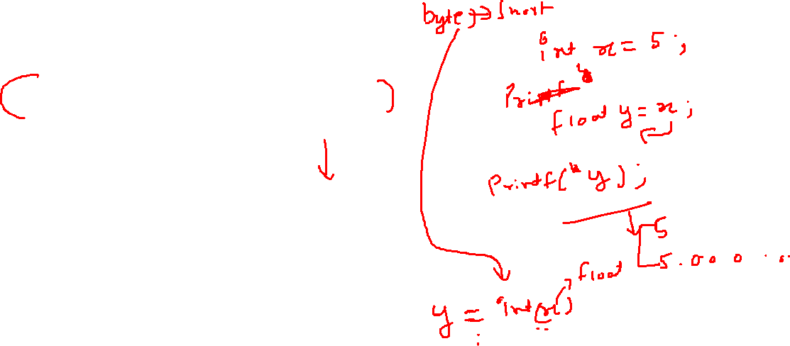
Type Casting
Assigning a value of one type to a variable of another type is known as Type Casting.
In Java, type casting is classified into two types,
Widening/Automatic Type Casting (Implicit)
Narrowing Type Casting(Explicitly done)

Slide 25
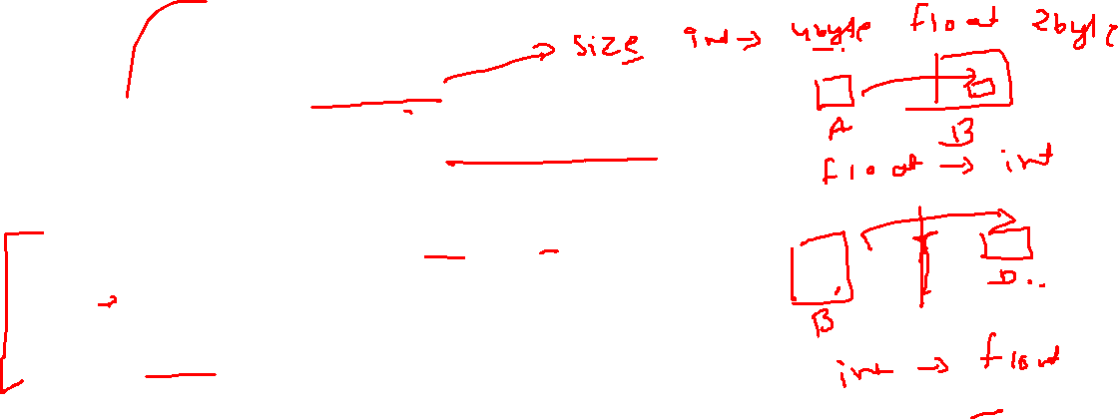
Automatic Type Casting
When one type of data is assigned to other type of variable , an automatic type conversion will take place if the following two conditions are satisfied:
The two types are compatible
The destination type is larger than the source type
Such type of casting is called “widening conversion”.
Example:
int can always hold values of byte and short
public static void main(String[] args) {
byte b = 5;
// √ this is correct
int a = b;
}

Slide 26
Casting Incompatible Types
To create a conversion between two incompatible types, you must use a cast
A cast is an explicit type conversion.
Such type is called “narrowing conversion”.
Syntax:
(target-type) value
Example:
public static void main(String[] args) {
int a = 5;
// × this is not correct
byte b = a;
// √ this is correct
byte b = (byte)a ;
}

Slide 27
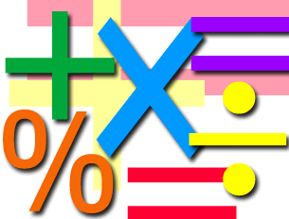
Operator
Perform definite operation

Slide 28
Operators
Arithmetic Operators
Relational Operators
Bitwise Operators
Logical Operators
Assignment Operators
Conditional / Ternary Operator
Instance of Operator

Slide 29
Operators
An operator is a symbol to perform specific mathematical or logical functions.
We use operators in maths to perform certain operations, e.g. +, -, *, /, etc.
Unary operators (++, --) take one operand, Binary operators (+, -, *, /) take two operands.
Programming languages are rich in operators which can be divided in following categories,
Sr. | Operator | Examples
1 | Arithmetic Operators | +, -, *, /, %
2 | Relational Operators | <, <=, >, >=, ==, !=
3 | Logical Operators | &&, ||, !
4 | Assignment Operators | =, +=, -=, *=, /=
5 | Increment and Decrement Operators | ++, --
6 | Conditional Operator | ?:
7 | Bitwise Operators | &, |, ^, <<, >>

Slide 30
Arithmetic Operators
An arithmetic operator performs basic mathematical calculations such as addition, subtraction, multiplication, division etc on numerical values (constants and variables).
Operator | Meaning | Example | Description
+ | Addition | a + b | Addition of a and b
- | Subtraction | a – b | Subtraction of b from a
* | Multiplication | a * b | Multiplication of a and b
/ | Division | a / b | Division of a by b
% | Modulo division- remainder | a % b | Modulo of a by b

Slide 31
Relational Operators
A relational operators are used to compare two values.
They check the relationship between two operands, if the relation is true, it returns 1; if the relation is false, it returns value 0.
Relational expressions are used in decision statements such as if, for, while, etc…
Operator | Meaning | Example | Description
< | is less than | a < b | a is less than b
<= | is less than or equal to | a <= b | a is less than or equal to b
> | is greater than | a > b | a is greater than b
>= | is greater than or equal to | a >= b | a is greater than or equal to b
== | is equal to | a == b | a is equal to b
!= | is not equal to | a != b | a is not equal to b

Slide 32
Relational Operators
Note : A = 10 & B = 20
Operator | Description | Example
== | Equals | (A == B) is not true.
!= | Not Equals | (A != B) is true.
> | Greater than | (A > B) is not true.
< | Less than | (A < B) is true.
>= | Greater than equals | (A >= B) is not true.
<= | Less than equals | (A <= B) is true.

Slide 33
Bitwise Operators
Note : A = 60 & B = 13
Operator | Description | Example
& | Binary AND Operator | A & B = 12 which is 0000 1100
| | Binary OR Operator | A | B = 61 which is 0011 1101
^ | Binary XOR Operator | A ^ B = 49 which is 0011 0001
~ | Binary Ones Complement Operator | ~A = -61 which is 1100 0011 in 2's complement form due to a signed binary number.
<< | Binary Left Shift Operator | A << 2 = 240 which is 1111 0000
>> | Binary Right Shift Operator. | A >> 2 = 15 which is 1111
>>> | Shift right zero fill operator. | A >>>2 = 15 which is 0000 1111

Slide 34
Logical Operators
Logical operators are decision making operators.
They are used to combine two expressions and make decisions.
An expression containing logical operator returns either 0 or 1 depending upon whether expression results false or true.
Operator | Meaning | Example (Let’s assume c=5 and d=2)
&& | Logical AND. True only if all operands are true | expression ((c==5) && (d>5)) equals to 0.
| | | Logical OR. True only if either one operand is true | expression ((c==5) || (d>5)) equals to 1.
! | Logical NOT. True only if the operand is false | expression !(c==5) equals to 0.
a | b | a && b | a || b
0 | 0 | 0 | 0
0 | 1 | 0 | 1
1 | 0 | 0 | 1
1 | 1 | 1 | 1

Slide 35
Logical Operators
Note : A = true & B = false
Operator | Description | Example
&& | Logical AND operator | (A && B) is false.
|| | Called Logical OR Operator | (A || B) is true.
! | Called Logical NOT Operator | !(A && B) is true.

Slide 36
Assignment Operators
Assignment operators are used to assign a new value to the variable.
The left side operand of the assignment operator is a variable and right side operand of the assignment operator is a value or a result of an expression.
Meaning of = in Maths and Programming is different.
Value of LHS & RHS is always same in Math.
In programming, value of RHS is assigned to the LHS
Operator | Meaning
= | Assigns value of right side to left side. Suppose a=5 and b=10. a=b means now value of a is 10.
+= | a += 1 is same as a = a + 1 | Shorthand Assignment Operators
-= | a -= 5 is same as a = a – 5
*= | a *= b is same as a = a * b
/= | a /= c is same as a = a / c
%= | a %= 10 is same as a = a % 10

Slide 37
Assignment Operators
Operator | Description | Example
= | Simple assignment operator | C = A + B will assign value of A + B into C
+= | Add AND assignment operator | C += A is equivalent to C = C + A
-= | Subtract AND assignment operator | C -= A is equivalent to C = C - A
*= | Multiply AND assignment operator | C *= A is equivalent to C = C * A
/= | Divide AND assignment operator | C /= A is equivalent to C = C / A
%= | Modulus AND assignment operator | C %= A is equivalent to C = C % A
<<= | Left shift AND assignment operator | C <<= 2 is same as C = C << 2
>>= | Right shift AND assignment operator | C >>= 2 is same as C = C >> 2
&= | Bitwise AND assignment operator | C &= 2 is same as C = C & 2
^= | bitwise exclusive OR and assignment operator | C ^= 2 is same as C = C ^ 2
|= | bitwise inclusive OR and assignment operator | C |= 2 is same as C = C | 2

Slide 38
Increment / Decrement Operators
Increment and decrement operators are unary operators that add or subtract one, to or from their operand.
the increment operator ++ increases the value of a variable by 1, e.g. a++ means a=a+1
the decrement operator -- decreases the value of a variable by 1. e.g. a–– means a=a–1
If ++ operator is used as a prefix (++a) then the value of a is incremented by 1 first then it returns the value.
If ++ operator is used as a postfix (a++) then the value of a is returned first then it increments value of a by 1.
Expression | Evaluation (Let’s say a=10, c=15)
b = a++ | Value of b would be 10 and value of a would be 11.
b = ++a | Value of b & a would be 11.
b = a-- | Value of b would be 10 and value of a would be 9.
b = --a | Value of b & a would be 9.
Expression
b = --a + c++
b = a++ + ++c
b = ++a - ++c
Evaluation (Let’s say a=10, c=15)
b = 24
b = 26
b = –5

Slide 39
Conditional Operator (Ternary)
Conditional Operator ( ? : )
Syntax:
variable x = (expression) ? value if true : value if false
Example:
b = (a == 1) ? 20 : 30;

Slide 40
Operator Precedence & Associativity
How does java evaluate 1 + 10 * 9 ?
(1 + 10 ) * 9 = 99 OR 1 + (10 * 9) = 91
To get the correct answer for the given problem Java came up with Operator precedence. ( multiplication have higher precedence than addition so correct answer will be 91 in this case)
For Operator, associativity means that when the same operator appears in a row, then to which direction the expression will be evaluated.
How does java evaluate 1 * 2 + 3 * 4 / 5 ???
2 + 12 / 5
2 + 2.4
4.4

Slide 41
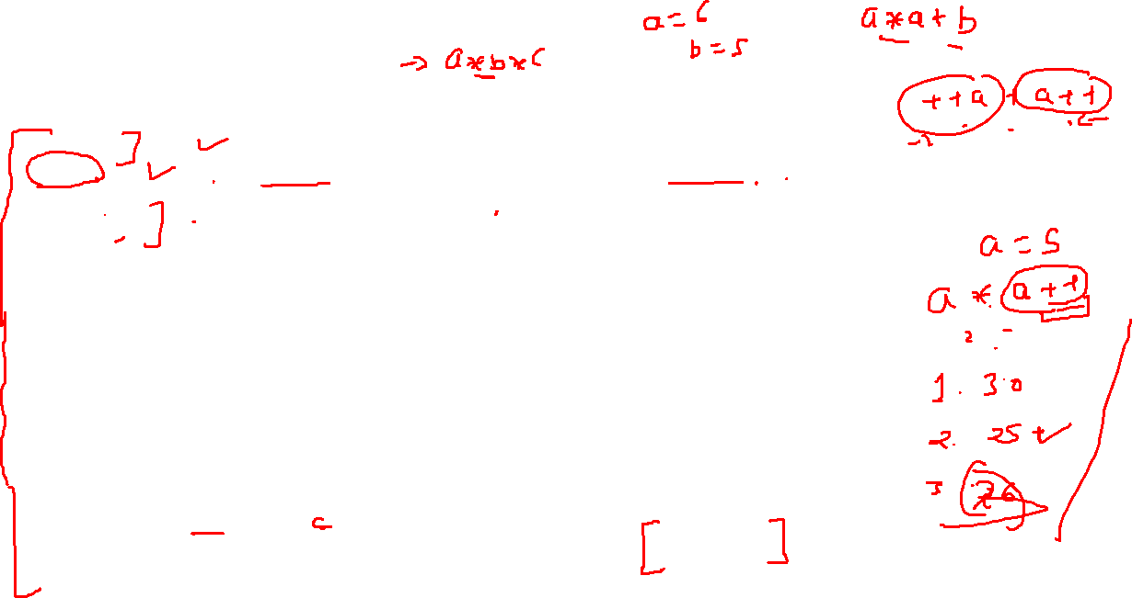
Precedence of Java Operators
Category | Operator | Associativity
Postfix | () [] . (dot operator) | Left to right
Unary | ++ - - ! ~ | Right to left
Multiplicative | * / % | Left to right
Additive | + - | Left to right
Shift | >> >>> << | Left to right
Relational | > >= < <= | Left to right
Equality | == != | Left to right
Bitwise AND | & | Left to right
Bitwise XOR | ^ | Left to right
Bitwise OR | | | Left to right
Logical AND | && | Left to right
Logical OR | || | Left to right
Conditional | ?: | Right to left
Assignment | = += -= *= /= %= >>= <<= &= ^= |= | Right to left
Comma | , | Left to right

Slide 42
Operators Precedence & Associativity
Priority matters!

Slide 43
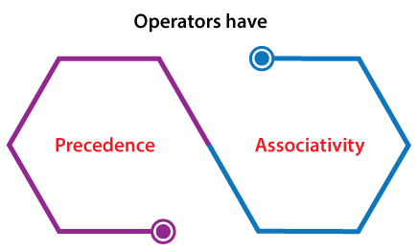
Operators Precedence & Associativity
Operators Precedence and Associativity are two characteristics of operators that determine the evaluation order of sub-expressions in absence of brackets.
Operator precedence determines which operation is performed first in an expression with more than one operators with different precedence.
a=10 + 20 * 30 is calculated as 10 + (20 * 30) and not as (10 + 20) * 30 so answer is 610.
Operators Associativity is used when two operators of same precedence appear in an expression. Associativity can be either Left to Right (L to R) or Right to Left (R to L).
a=100 / 10 * 10
If Left to Right means (100 / 10) * 10 then answer is 100
If Right to Left means 100 / (10 * 10) then answer is 1
Division (/) & Multiplication (*) are Left to Right associative so the answer is 100.

Slide 44
Operators Precedence and Associativity
1) Associativity is only used when there are two or more operators of same precedence.
2) All operators with the same precedence have same associativity
Priority | Operator | Description | Associativity
1 | ( ) [ ] . -> a++ a— | Parentheses (function call) Brackets (array subscript) Member selection via object name Member selection via pointer Postfix increment/decrement | left-to-right
2 | ++a —a + – ! ~ (type) * & sizeof | Prefix increment/decrement Unary plus/minus Logical negation/bitwise complement Cast (convert value to temporary value of type) De-reference Address (of operand) Determine size in bytes on this implementation | right-to-left
3 | * / % | Multiplication/division/modulus | left-to-right
4 | + – | Addition/subtraction | left-to-right
5 | << >> | Bitwise shift left, Bitwise shift right | left-to-right
6 | < <= > >= | Relational less than/less than or equal to Relational greater than/greater than or equal to | left-to-right
Priority | Operator | Description | Associativity
7 | == != | is equal to/is not equal to | left-to-right
8 | & | Bitwise AND | left-to-right
9 | ^ | Bitwise exclusive OR | left-to-right
10 | | | Bitwise OR | left-to-right
11 | && | Logical AND | left-to-right
12 | | | | Logical OR | left-to-right
13 | ? : | Ternary conditional | right-to-left
14 | = += -= *= /= %= &= ^= |= <<= >>= | Assignment Shorthand Assignments Bitwise exclusive/inclusive assignment Bitwise shift left/right assignment | right-to-left
15 | , | Comma (separate expressions) | left-to-right

Slide 45
Exercise
Sr. | Exercise
1. | int i=1; i=2+2*i++;
2. | int a=2,b=7,c=10; c=a==b;
3. | int a=2,b=7,c=10; c=a!=b;
4. | int a=100 + 200 / 10 - 3 * 10
5. | int a = 2, b = 6, c = 12, d; d = a * b + c / b; printf("The value of d = %d ", d);
Answer
4
0
1
90
14

Slide 46
Thank You

